Slide 1
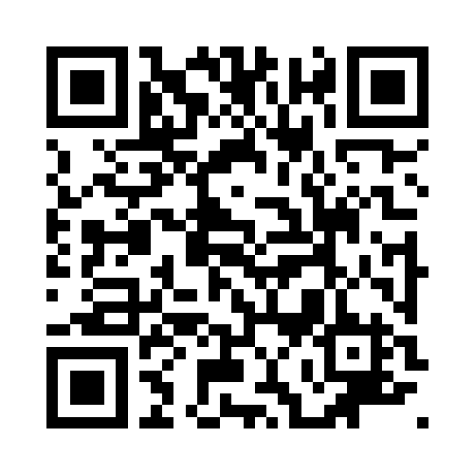
Share the Joy
of Christmas
Make a Christmas Hamper or donate Christmas treats for a local individual or family in need
Box of chocolates
Box or nice packet of biscuits
Pudding, eg Christmas pudding
Savoury snacks, eg nuts, crackers
Tinned meat (no pies)
Tinned fish
Cooking sauce
Dried stuffing
Box of mince pies
Tinned fruit
Cake
Jam
No alcohol, please
Hot drink, eg tea, coffee
Toiletries (male/female)
Christmas Crackers
Please bring donations to:
-Festival Place (UG floor, opp Apple) 9.30am-5.30pm Mon to Sat, or
-Basingstoke Foodbank, Houndmills (RG21 6XG) 9.30am-3pm Mon to Fri
We also need helpers to assemble hampers from 1st to 23rd December.
Email: hampers@basingstoke.foodbank.org.uk
Telephone: 07747-111336
Website: https://www.thebesominbasingstoke.org/hampers

