Slide 1
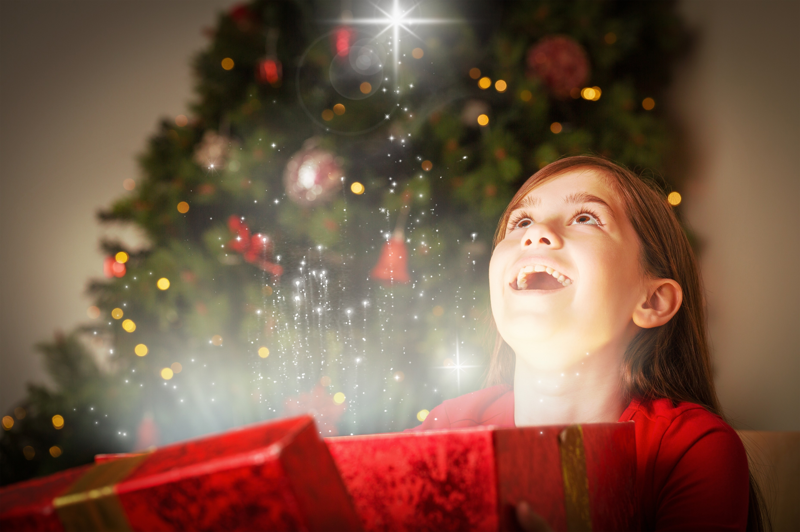
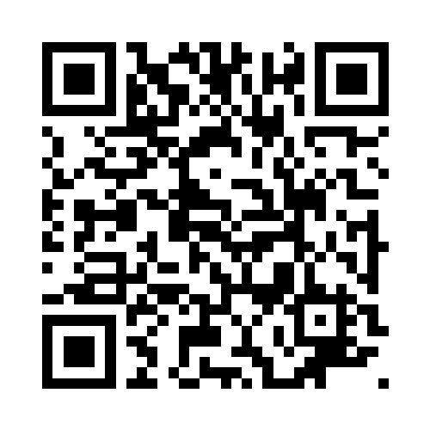

Share the Joy of Christmas
Make a Christmas Hamper or donate Christmas treats for a local individual or family in need.
If you would like to make a hamper, please base its contents on the lists below, so that the hamper will contain a variety of Christmas treats, without being too heavy to carry.
Please bring donations to:
- Festival Place (UG floor, opp Apple) 9.30am-5.30pm Mon to Sat, or
- Basingstoke Foodbank, Houndmills (RG21 6XG) 9.30am-3pm Mon to Fri.
For more information: https://www.thebesominbasingstoke.org/hampers or
Contact Abigail at hampers@basingstoke.foodbank.org.uk or on 07747-111336

